Slide 1
EMV and Cryptography
DRAFT – 11/12/2013

Slide 2
Introduction
EMV specifications use various RSA keys and symmetric DES keys
RSA keys and certificates are used for providing integrity i.e. proving to the terminal that the card is authentic (offline data authentication)
Symmetric DES keys are used during “online” transactions where card authentication (to Issuer) and Issuer authentication (to Card) is involved

Slide 3
Certificates and Keys

Slide 4
Certificates
Issuer Realm
Scheme CA Realm
Issuer generates 2 RSA key pairs (ICC and Pin Encipherment) signed by its private key (DDA/CDA)
Generate CSR (Certificate Signing Request
Validate CSR
Issuer Certificate (P_{I})
Generate Signed Issuer Certificate
CA Certificate
CA Self Signed Certificate
ICC RSA Key Pair(SICC/PICC)
Pin Encipherment RSA Key Pair(SPE/PPE)
Data Preparation System
Card Member Specific Data File
IC Terminal
Chip Card

Slide 5
Certificate Generation..
A CSR is basically a self signed certificate created by the Issuer
The scheme CA validates the CSR and signs it using the CA’s private key
The DP system could be a outsourced system our could be run by the Issuer itself
It creates all of the data required on the chip and feeds it into the chip during personalization
Based on the type of card (SDA/DDA/CDA) different certificates may be involved

Slide 6
SDA
Static Application Data
Private Key (Issuer) S_{I}
Public Key (Issuer) P_{I}
Private Key (CA) S_{CA}
Public Key (CA) P_{CA}
Signed Static Application Data (SSAD)
Chip Card
Issuer PK Certificate
Card Acceptance Device (Terminal)
Chip to Terminal
Issuer PK Certificate (P_{I} signed by CA using S_{CA})
Signed Static Application Data (signed by Issuer using S_{I})
Terminal
Uses P_{CA} to verify that P_{I} was signed by CA
Uses P_{I} to verify that SSAD was signed by Issuer
Issuer
Certificate Authority (CA)
Acquiring

Slide 7
DDA/CDA
Public Key (ICC) P_{ICC}
Static Application Data
Private Key (Issuer) S_{I}
Public Key (Issuer) P_{I}
Private Key (CA) S_{CA}
Public Key (CA) P_{CA}
ICC PK Certificate
Private Key (ICC) S_{ICC}
Chip Card
Issuer PK Certificate
Card Acceptance Device (Terminal)
Chip to Terminal
Issuer PK Certificate (P_{I} signed by CA using S_{CA})
ICC PK Certificate (P_{IC} + SAD signed by Issuer using S_{I})
Card and Terminal Dynamic Data (signed by Card using S_{IC})
Terminal
Uses P_{CA} to verify that P_{I} was signed by CA
Uses P_{I} to verify that Card P_{IC} and SAD were signed by Issuer
Uses P_{IC} to verify card’s signature on dynamic data
Issuer
Certificate Authority (CA)
Acquiring

Slide 8
Symmetric (TDES) Keys
An Issuer can have more than one IMK, one each for AC (cryptogram), MAC’ing and Encryption
Issuer Master Key
(IMK)
Created based on PAN by either the DP system or the Issuer
Generate Card Specific Keys
Placed inside the chip during personalization
Chip Card
An Issuer will have at least one IMK (but could have 3 IMK’s each for cryptogram generation, MAC’ing and data encryption)
There could be a maximum of 3 card specific DES keys based on IMK’s
Card specific keys are generated based on a function of IMK and PAN

Slide 9
Algorithms

Slide 10
ICC Master Key Derivation (Option A)
If less than 16 digits, pad left with 0x00’s. If more than 16, pick rightmost 16
If PAN sequence number is absent default to 00
Y=PAN || PAN Sequence Number
IMK
(Issuer Master Key)
IMK
(Issuer Master Key)
16 X 0xFF
DES3 Encryption
DES3 Encryption
ZL
ZR
MKAC = ZL || ZR
This algorithm is used to derive the card specific (ICC) master keys from the Issuer Master Key (IMK)
These keys are placed into the card during personalization

Slide 11
Session Key Derivation Function
Base Diversification Value
ATC || 00 00 00 00 00 00
Diversification Value Left
ATC || F0 00 00 00 00 00
Diversification Value Left
ATC || 0F 00 00 00 00 00
DES3 Encryption
(ICC AC Master Key)
MK_{AC}
Session Key Left (SK_{L})
Session Key Right (SK_{R})
Session Key (SK_{AC})

Slide 12
Cryptogram Generation
ICC AC Master Key (MK_{AC})
Session Key Derivation Function
Data from Terminal
Amount Authorized
Amount Other
Session Key (SK_{AC})
Terminal Country Code
Terminal Verification Results
Transaction Date
MAC Algorithm
Transaction Type
Unpredictable Number
Amount Other
Application Cryptogram (AC)
Data from ICC
Application Interchange Profile
Application Transaction Counter
A cryptogram (also called AC) is generated during the “online” scenario
A cryptogram is basically a 8 byte value generated by using the DES algorithm on set of data elements gathered from the chip and terminal during transaction processing

Slide 13
Cryptogram (ARQC)/MAC Algorithm
ISO/IEC 7816-4
“Add a trailing 0x80 to data and add smallest number of 0x00 bytes until the resulting message is multiple of 8 bytes”
Data Padding
(per ISO/IEC 7816-4)
Split into blocks, each containing 8 bytes
Split Data Block
(N data blocks)
Initial IV (Initialization Vector)
00 00 00 00 00 00 00 00
For I = 0 to N
DES3 (CBC Mode)
SK_{AC}
A second method does a DES encryption on all blocks (using SK_{ACL} ) followed by decryption using SK_{ACR} and encryption using SK_{ACL} on the result.
Result of Final DES Operation
Application Cryptogram

Slide 14
ARPC Generation
ARC (Authorization Response Code) is a two byte value usually generated by the Issuer and sent in the IAD –
Z1 – Offline Decline
Y1 – Offline Approve
Z3 – Offline Decline (unable to go online)
Y3 – Offline Approve (unable to go online)
00 – Approve
02 – Referral
05 – Decline
X = ARC || 00 00 00 00 00 00
Y = ARQC XOR X
DES3
SK_{AC}
The ARPC is the cryptogram generated by the Issuer after validating the request cryptogram (ARQC). This is validated by the card and proves that the response is genuine and originates from the Issuer.
ARPC

Slide 15
Examples

Slide 16
CSR
A CSR or Certificate Signing Request contains the following
Common Name
Organization
Organization Unit
City
State
Country
Email Address
Public Key
During CSR creation a private key is also created which has to be safely preserved
Notes:
http://www.sslshopper.com/what-is-a-csr-certificate-signing-request.html

Slide 17
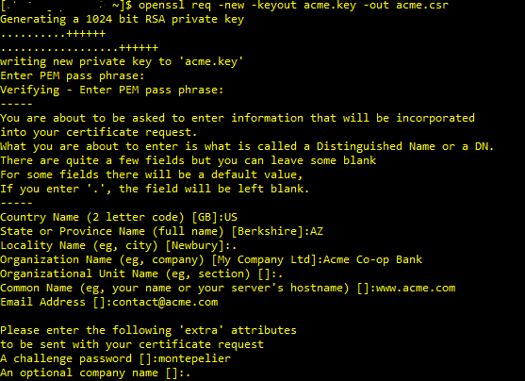
CSR Creation Example (Using Openssl)
The file acme.key will contain the private key and acme.csr is the csr file to be sent to CA for signing
A key size can also be supplied by adding an additional parameter –newkey rsa:2048
Note: This is just an illustration of the process involved. CSR generation is typically done using a HSM and the generated private key is stored in secure storage.

Slide 18
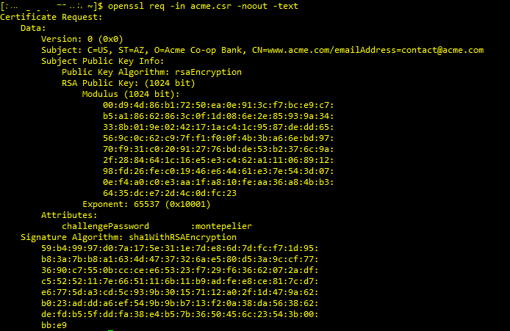
View a CSR

Slide 19
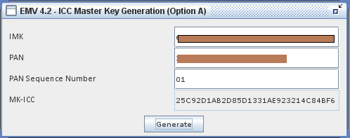
ICC Master Key Generation using NetSim
IMK – Issuer Master Key
PAN – Primary Account Number
MK-ICC – ICC Master Key

Slide 20
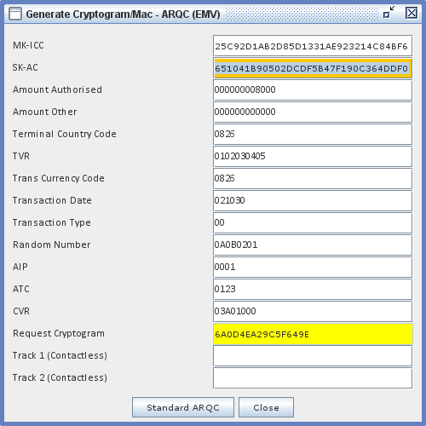
Application Cryptogram (ARQC) Generation using NetSim
MK-ICC (ICC Master Key) derived in the previous screen
SK-AC (Session Key) derived from ATC
ARQC (Application Request Cryptogram) supplied to the Issuer (typically in F55)

Slide 21
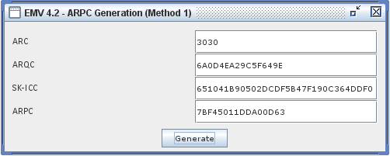
ARPC generated using NetSim
ARQC generated by chip (see previous slide)
ARPC (Application Response Cryptogram) generated by Issuer and sent to chip in response
SK-ICC – Session Key

Slide 22
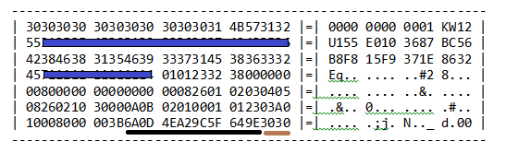

ARQC Validation and ARPC generation using Thales 9000 HSM
HSM Request
ARQC
ARC
(Authorization Response Code)
ARPC
(Authorization Response Code)
HSM Response
Response Code 00 indicating successful ARQC validation

